Slide 1
Fundamentals of Information Technology
S.S.NACHIYA
DEPT., OF C.S.,

Slide 2
Kinds of Software
Software
In a computer system, the software is basically a set of instructions or commands that tells a computer what to do. Or in other words, the software is a computer program that provides a set of instructions to execute a user’s commands and tell the computer what to do.
For example like MS-Word, MS-Excel, PowerPoint, etc. The chart below describes the types of software:

Slide 3
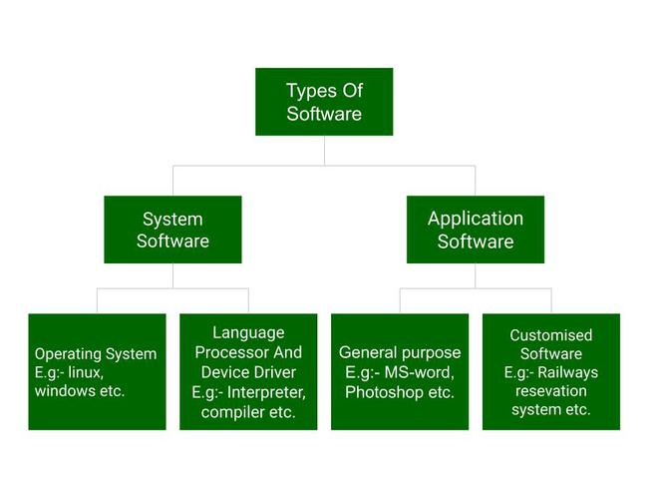
Kinds of software

Slide 4
Application Software
Software that performs special functions or provides functions that are much more than the basic operation of the computer is known as application software. Or in other words, application software is designed to perform a specific task for end-users. It is a product or a program that is designed only to fulfill end-users’ requirements. It includes word processors, spreadsheets, database management, inventory, payroll programs, etc.
Types
1)Word processing
2)Spreadsheets
3)Database software
4)Presentation graphics software
5)Communications software

Slide 5
Word Processing
Word Processing refers to the act of using a computer to create, edit, save and print documents. In order to perform word processing, specialized software (known as a Word Processor) is needed.
With a word processor, the user can type:
Letters
Memos
Examples of a Word Processor:
MS Word
Wordperfect
Wordstar
Lotus WordPro

Slide 6
Advantages of word processors
i) Documents can be created and stored for future use. For example documents
or files saved in a flash disk.
ii) Paperless document processing environment as documents are saved in
storage media.
iii) Most actions are automated. For example, word wrap automatically moves
the cursor to a new line on reaching the end of the current line; a new page
is automatically inserted on reaching the end of the current page.
iv) Word processors have editing tools such as spelling and grammar checkers,
thesaurus to easily and fast correct spelling and grammar mistakes.
v) Formatting features available help the user to make the document more
attractive and therefore more appealing to the eye.
vi) Many copies can be printed using a single document.
vii) A document can easily be edited without having to retype it.

Slide 7
Basic features:
Insert text: Allows you to insert text anywhere in the document
Delete text: Allows you to erase characters, words, lines, or passages.
Cut and paste: Allows you to remove a section of text from one place in a document and insert it somewhere else
Copy: Allows you to duplicate a section of text
Page size and Margins: allows you to define various page size and margins.
Search and replace: Allows you to search for a particular word or phrase and also replace one group of characters with another everywhere that first group appears.
Word wrap: The word processor automatically moves to the next line when you have filled one line with text.
Headers, footers, and page numbering: Allows you to specify customized headers and footers the word process will display at the top and bottom of every page
Font Specification: Allows you to change font attributes within a document.
Spell Checker: A utility that allows you to check the spelling of words. It will highlight any word that it does not recognize
Thesaurus: Allows you to search for synonyms without leaving the word processor

Slide 8
Steps Involved in Loading Microsoft Word
There are many ways of loading Microsoft word:
a. If the icon of the package is on desktop, double click on it for it to open
b. If the icon is not on the desktop, follow the step below:
i. Click the Start Button
ii. Click on all program
iii. Select and click Microsoft office
iv. Select and click Microsoft Word

Slide 9
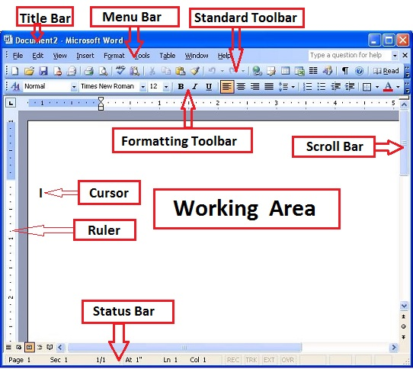
PARTS OF A WORDPROCESSING APPLICATION WINDOW

Slide 10
Title bar
This displays the document name followed by a program name.
Menu bar
This contains a list of options to manage and customize documents.
Standard toolbar
This contains shortcut buttons for the most popular commands.
Formatting toolbar
This contains buttons used for formatting.
Ruler
This is used to set margins, indents, and tabs.
Insertion point
This is the location where the next character appears.
End-of-document marker
This indicates the end of the document.
Help
This provides quick access to Help topics.

Slide 11
Scroll bars
These are used to view parts of the document.
Status bar
This displays the position of the insertion point and working mode buttons.
Task pane
This provides easy access to commonly used menus, buttons, and tools.
View buttons
These change the layout view of the document to normal, web layout, print
layout, and outline view.
Office Assistant
This links to the Microsoft Office Help feature.

Slide 12
PAGE FORMATTING
Applies to an entire page. Include the following:
i) Columns – Two, Three, Four etc
ii) Margins – blank spaces around a page (Left, Right, Top, Bottom)
iii) Paper size
iv) Page orientation – We have Portrait (Text and graphics are printed with the longest side
vertically upright) and Landscape (Text and graphics are printed with the longest side of
the page placed horizontally).
v) Headers – text that is displayed at the top of each page
vi) Footers – text that is displayed at the bottom of each page.
vii) Page numbers
viii) Page borders – use Page Layout option.
ix) Page colour - use Page Layout option.

Slide 13
MAIL MERGE
facility that helps one to create and generate personalised documents such as letters that can be sent to different recipients with different addresses. The following must be created;
i) Main document – letter to be sent to recipients
ii) Data source – contains addresses of the recipients
iii) Merged file- the resulting document that combines the main document and the relevant fields from the data source.
GRAPHICS
Can insert pictures from the Clip Art gallery. Use Insert option.
Objects and graphics can be formatted in a number of ways

